Slide 1
Ink Wash painting --- Style Transfer
Team 4
Member1 Xingjian Qu Member2 Zihang Zhu
REFERENCES:
[1] Zhang J., Bargal S. A., Lin Z., Brandt J., Shen X., & Sclaroff S. (2018). Top-down neural attention by excitation backprop – International Journal of Computer Vision, 126(10), 1084-1102.
[2] Bargal S. A.*, Zunino A.*, Kim D., Zhang J., Murino V. and Sclaroff S. (2018). Excitation Backprop for RNNs – Proc. IEEE Conf. on Computer Vision and Pattern Recognition (CVPR).
[3] Zunino A.*, Bargal S. A.*, Morerio P., Zhang J., Sclaroff S., & Murino V. (2018). Excitation Dropout: Encouraging Plasticity in Deep Neural Networks – arXiv preprint arXiv:1805.09092.

Slide 2
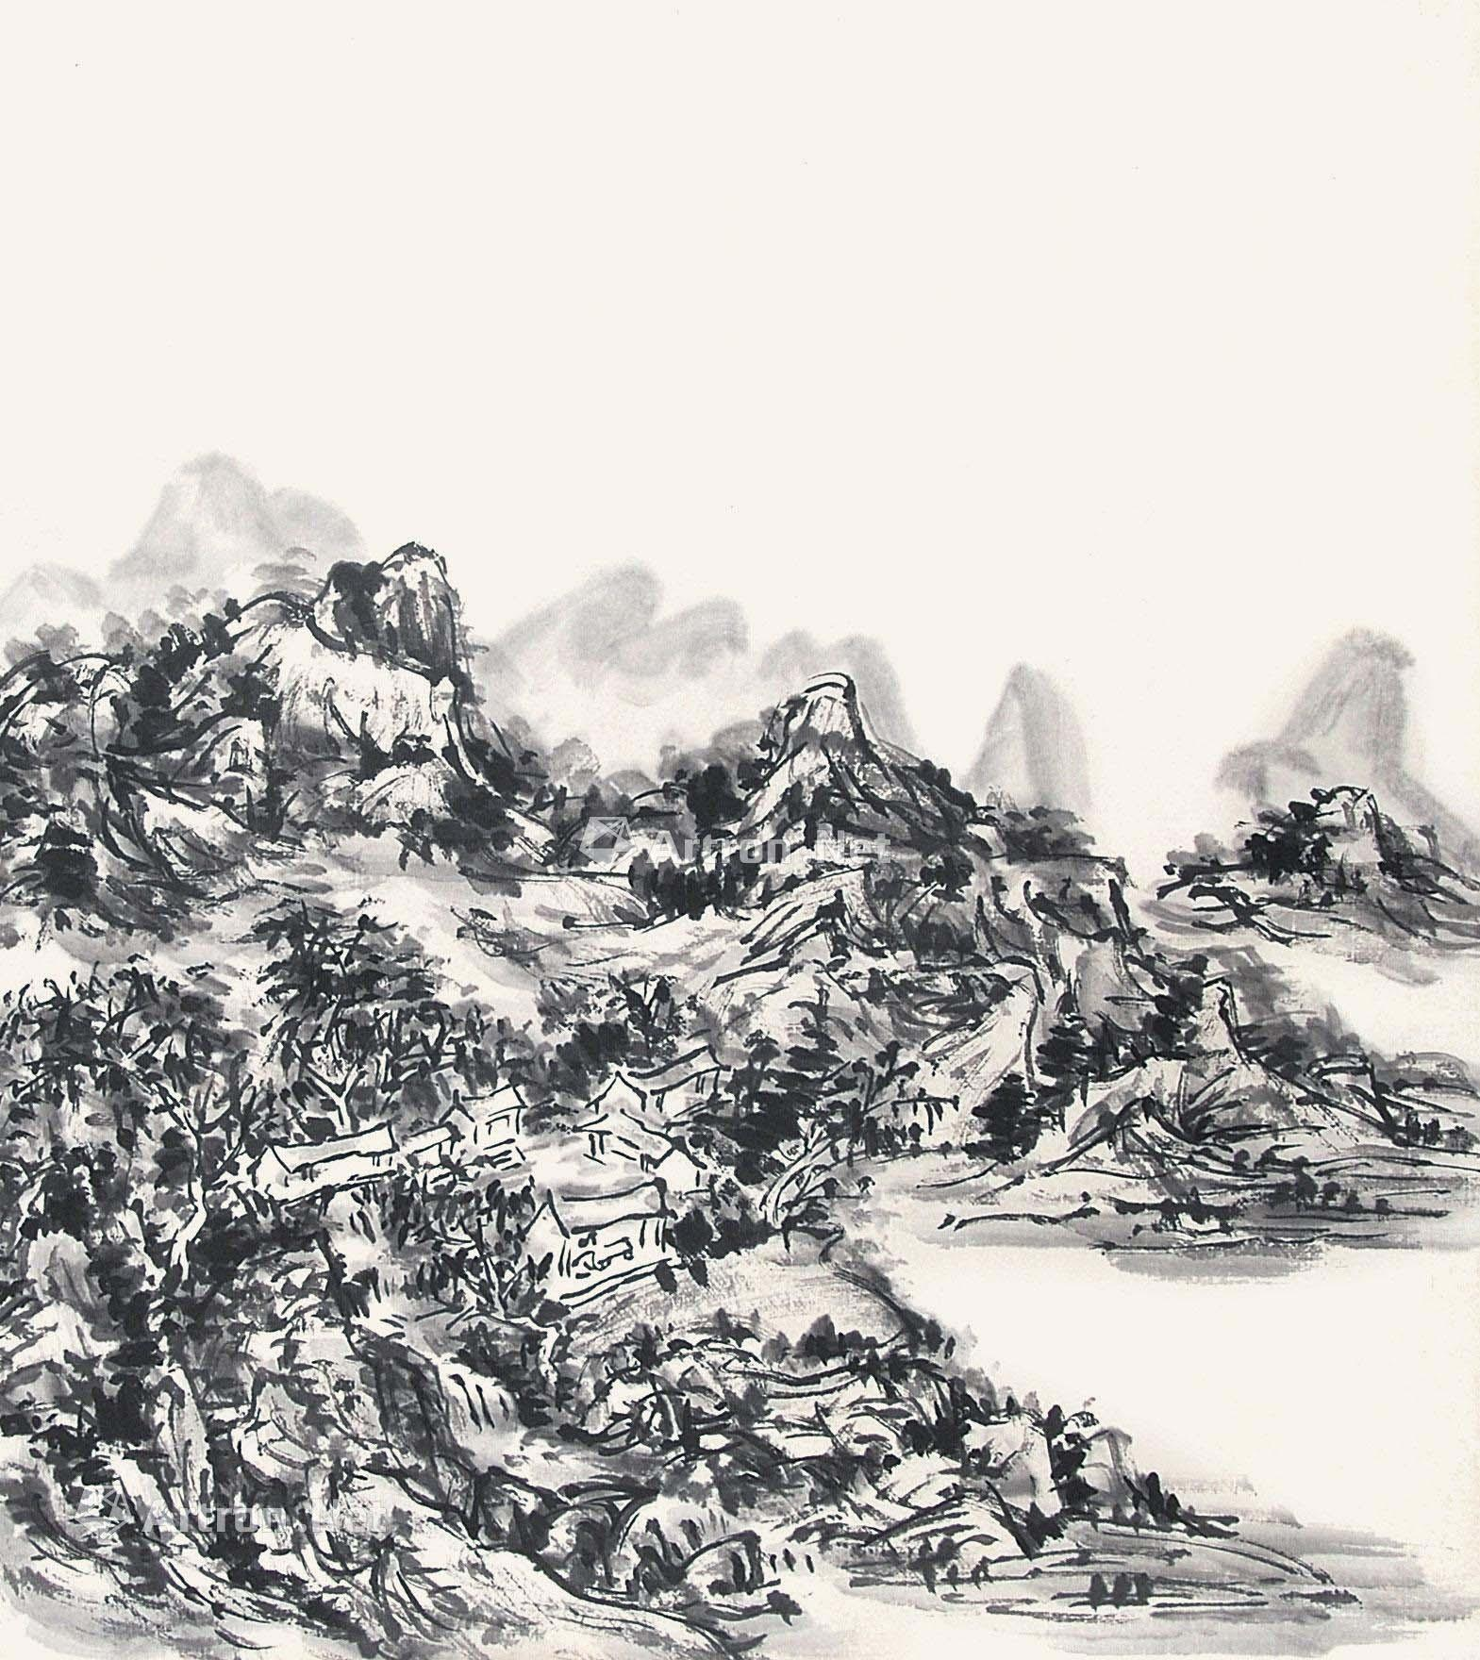
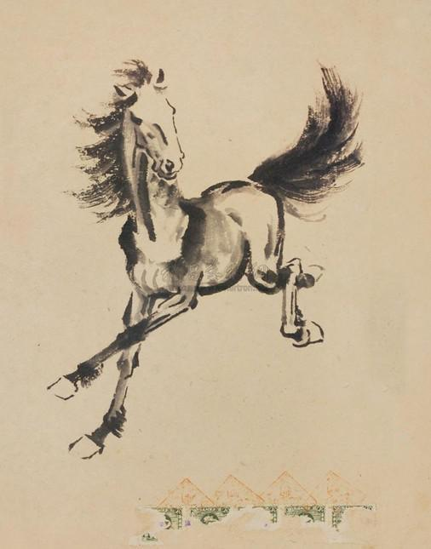
Background
What is ink wash painting?

Slide 3
Features
“Voids”
Color richness: ink with different gray levels.

Slide 4
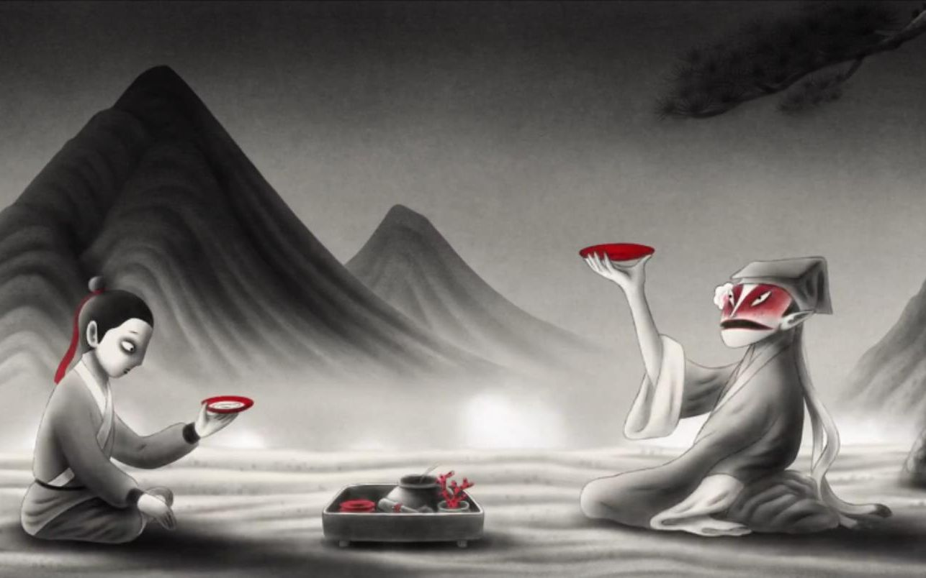
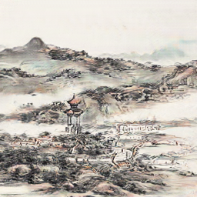
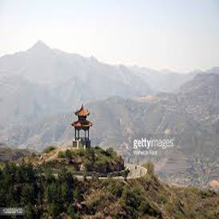
Motivation
Generation
Inspiration

Slide 5
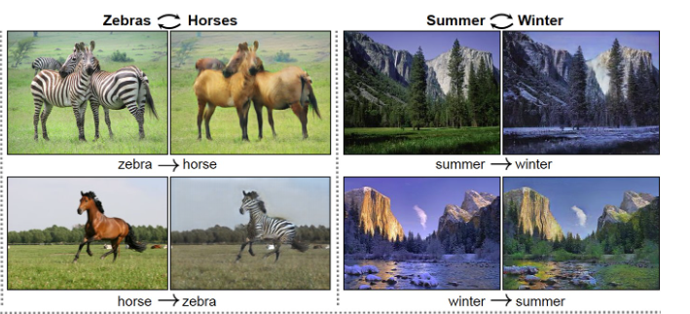
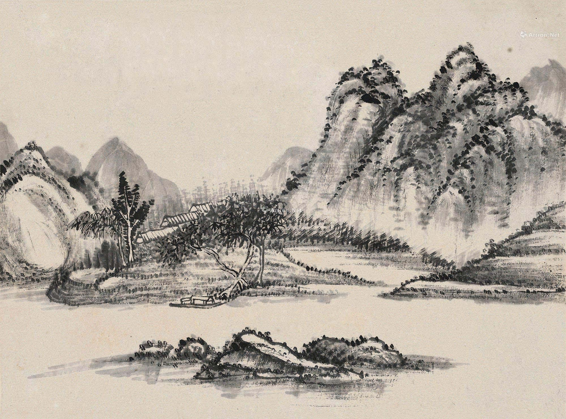
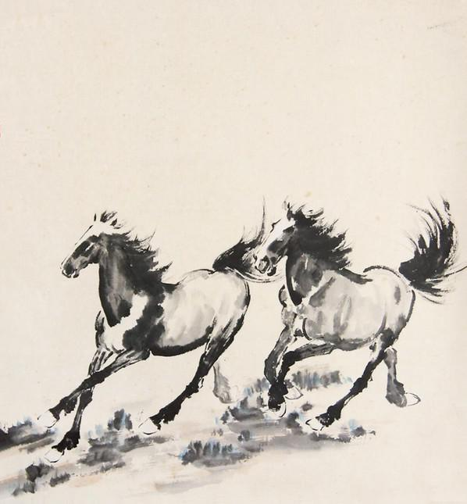
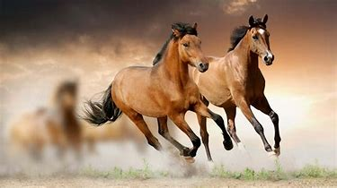
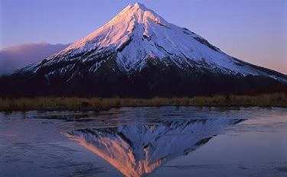
Goal
Model: CycleGan
What we want to do is to transfer real-life pictures into ink wash paintings.
Datasets:
Horses
and
Landscapes

Slide 6
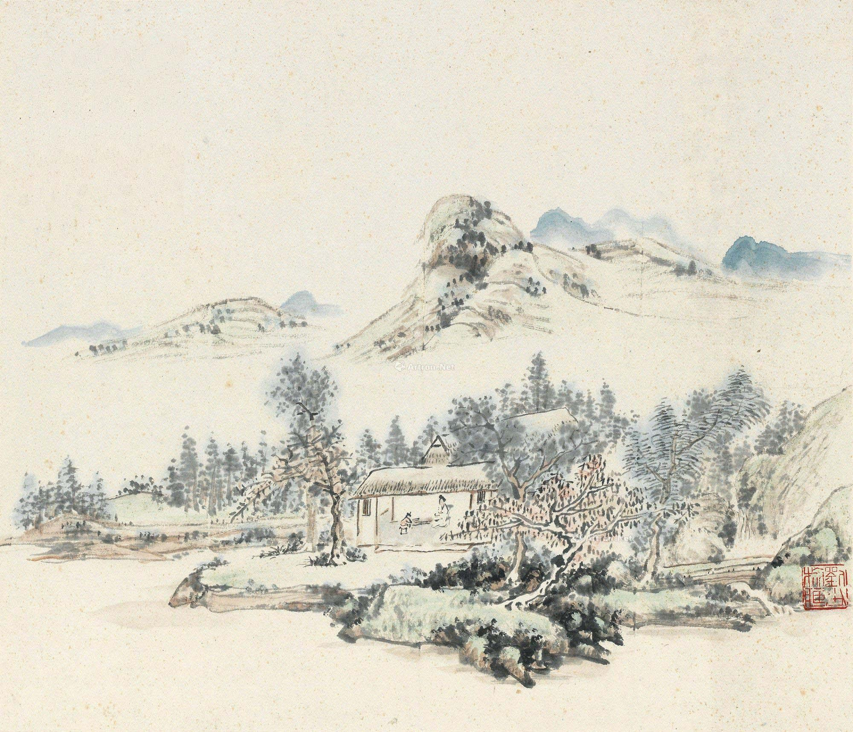
Horses
Landscapes

Slide 7
Main Reference Work(s)
[1] Justin Johnson, Alexandre Alahi, and Li Fei-Fei. Perceptual losses for real-time style transfer and super-resolution. In European conference on computer vision, pages 694–711. Springer, 2016.
[2] Jun-Yan Zhu, Taesung Park, Phillip Isola, and Alexei A Efros. Unpaired image-to-image translation using cycle-consistent adversarial networks. In Proceedings of the IEEE international conference on computer vision, pages 2223–2232, 2017.

Slide 8
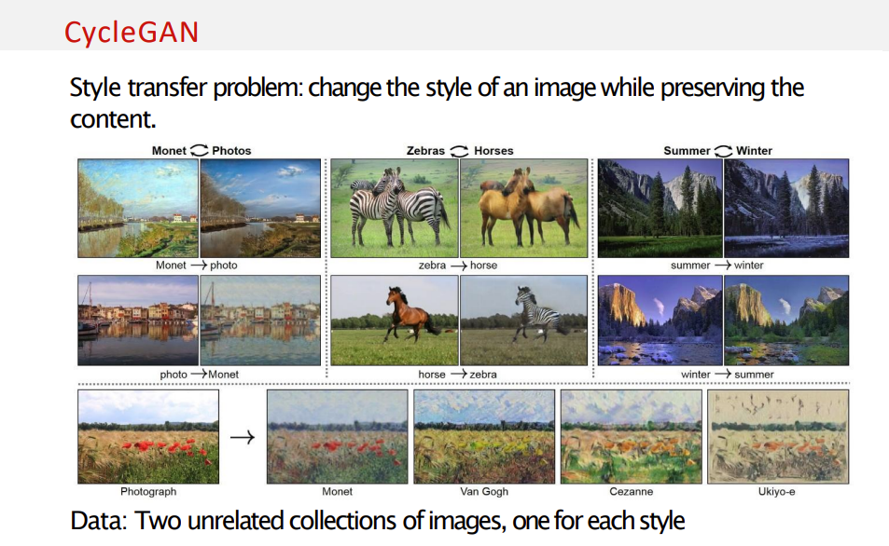
Method: CycleGan

Slide 9
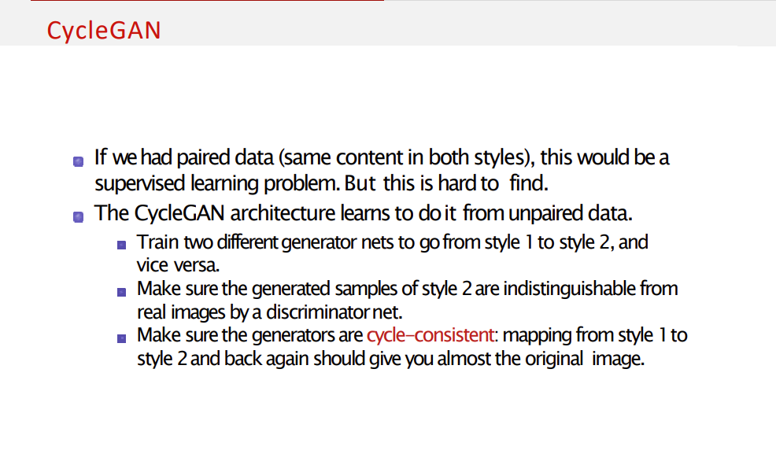

Slide 10
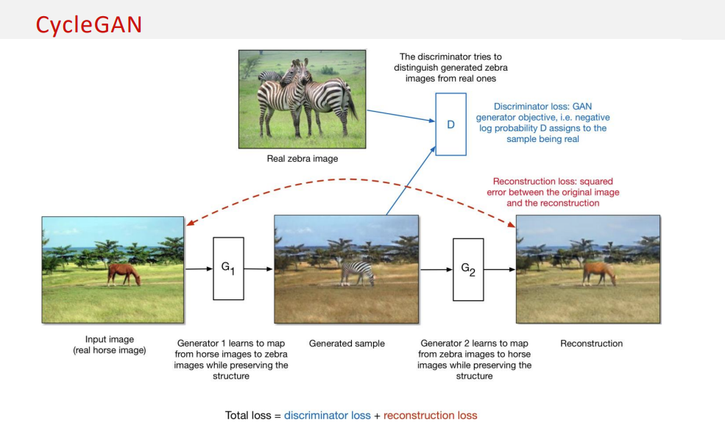
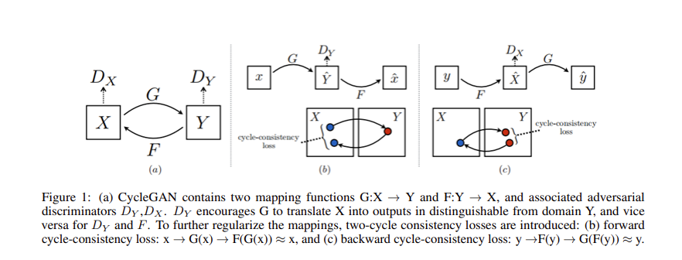
Architecture
Pipeline figure and details

Slide 11
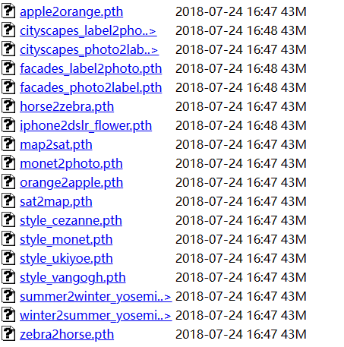
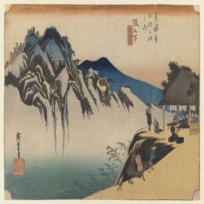
Training Details
1. Use Pretrained Model: Style Ukiyoe
Notes:
We tried some Hyper-parameter tuning on CycleGAN. The model that has the best performance was trained with the setup of learning rate: 0.0004, batch size: 1, and the number of epochs: 130. We raised the ratio of generators from realistic photos to ink drawings on the loss function from 1 to 1.5. In terms of model structure, in order to solve the checkerboard artifacts, we replace the ConvTranspose2d function in Resnet used for upsampling of the original CycleGAN model by upsampling + conv2d, and this modification successfully mitigates the checkerboard artifacts. According to the feedback of our investigation, it successfully reduces the chance that our generated images being recognized as computer-generated.

Slide 12
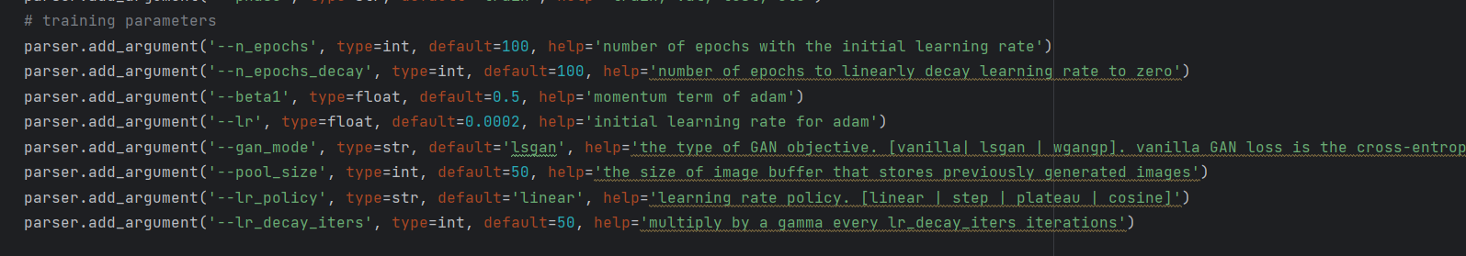
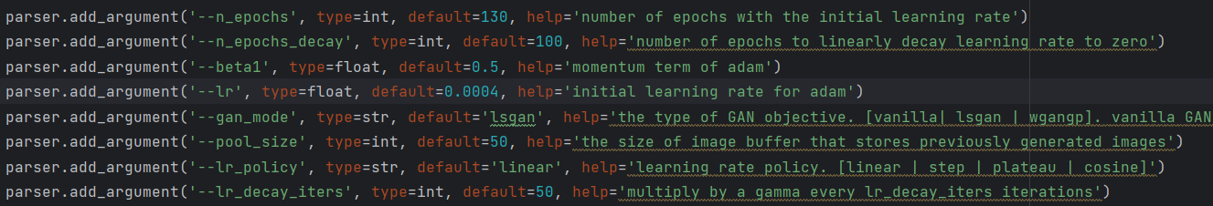
2. Fine-Tuning and Hyper-parameter tuning

Slide 13

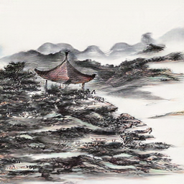
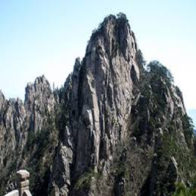
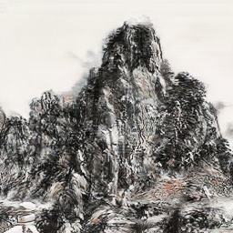
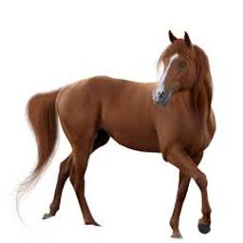
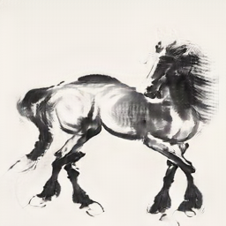
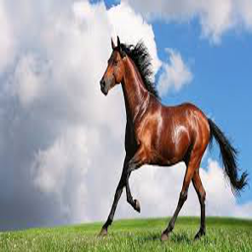
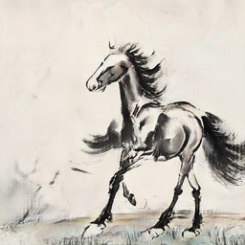
Experimental Results(What we want you to see)
Notes:
Human Study

Slide 14
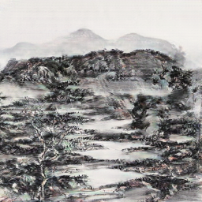
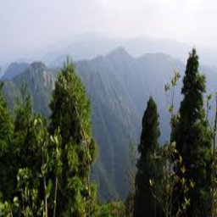
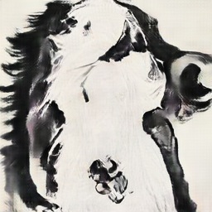
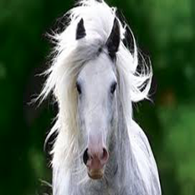
Experimental Results(What we don’t want you to see)
Notes:
Human Study

Slide 15
Github Link
https://github.com/StarFarming99/COSC_5470-CV

Slide 16
QUESTIONS?
Thank you!

